Slide 1
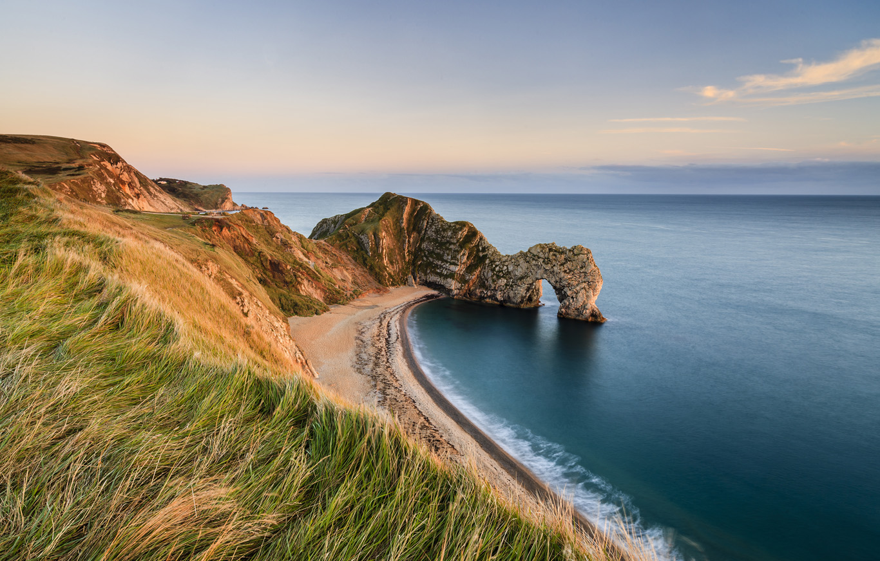
Coasts Revision Sheets – Answers
Processes:
Erosion
Weathering
Transportation
Longshore Drift
Wave types
Mass movement
Features:
Headland erosion
Spits & Bars
Coastal management:
Hard engineering
Soft engineering
Sea level rise:
Global warming
Impacts (Environmental, Economic, Political & Social)
Key
XXX – Key words
XXX – Definition
XXX – Case study

Slide 2
Types of erosion – How do they work?
1. Hydraulic action
- Waves crash against the cliff and force air in the cracks until bits of the cliff to break off.
2. Abrasion
- Eroded rock bits in the sea scrape against the cliff causing tiny bits to fall off
3. Attrition
- Eroded particles in the sea smash into each other and break into smaller particles
4. Solution
- Weak acid in the sea dissolves cliffs made of chalk
Longshore drift – Labelled diagram
(Key labels include: Prevailing wind, Swash, Backwash, Zig-Zag, sediment)
2 types of waves & their characteristics
1. Destructive
Made in storms close to the shore
Form big, strong waves when the wind is strong and has been blowing for a long time
Happen when the wave has travelled over a long distance (Fetch)
Stronger backwash than swash
High and steep
2. Constructive
Made in storms far away from the shore
Calmer than destructive waves/less powerful
Deposit material on the shore
Swash is stronger than the backwash
Low in height
Processes
Mechanical weathering = Breakdown of rocks without changing their chemical composition
e.g. Freeze-thaw
Water gets into cracks, freezes and expands, melts, more water enters crack, freezes and expands. Over time the crack gets wider and eventually causes the rock to break.
Chemical weathering = Breakdown of rocks by changing its chemical composition
e.g. Carbonation
Rainwater has carbon dioxide dissolved in it (a weak carbonic acid). The carbonic acid reacts with rocks that contain Calcium Carbonate. The rocks are dissolved by the rainwater.
Types of transportation – How do they work?
1. Traction
- Large particles like big boulders are rolled along the sea bed by the force of the water.
2. Saltation
- Pebble-sized particles are bounced along the seabed by the force of the water
3. Suspension
- Small particles like silt and clay are carried along in the water.
4. Solution
- Dissolvable sediment is dissolved in the water and carried alone
Mass movement
Slumping/rotational slips
Permeable rock (lets water through) on top of impermeable rock (does not allow water through)
This could be sand over clay
Water (such as rainwater) can travel through the sand at first but not the clay.
Water then collects at the bottom of the sand, between the sand and the clay.
This causes the cliff to become waterlogged and heavy
Eventually the force of gravity will be greater than the force supporting the cliff and cause it to slump
Describe the processes of erosion operating at the coast (4) _______________________________________________________________________________________
__________________________________________________________________________________________________________________________________________________________________________________________________________________________________________________________________________________
Explain the process of longshore drift using an annotated diagram (6) _________________________________________________________________________________
___________________________________________________________________________________________________________________________________________________________________________________________________________________________________________________________________________________________________________________________________________________________________________________________________________________________
Compare and contrast constructive and destructive waves (4) _______________________________________________________________________________________
__________________________________________________________________________________________________________________________________________________________________________________________________________________________________________________________________________________

Slide 3
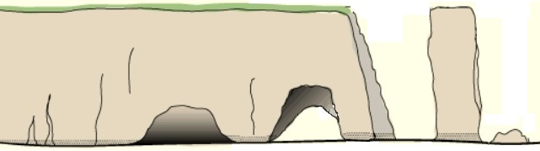
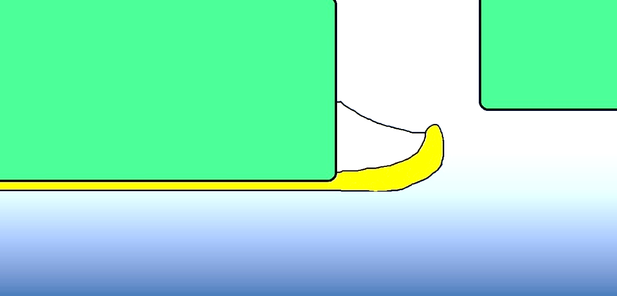
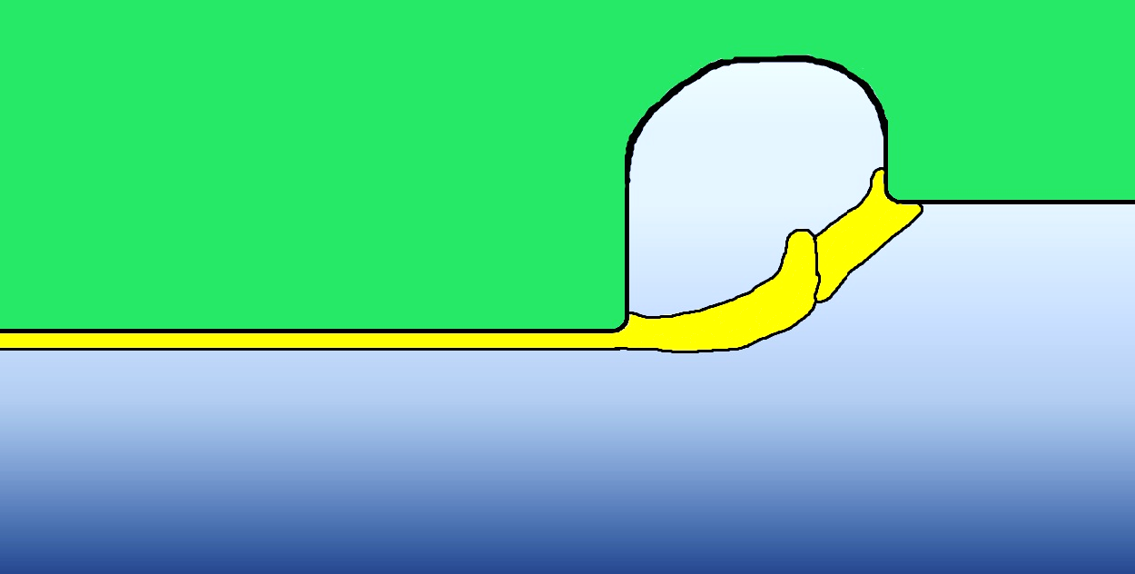
What features are shown here?
Crack, Cave, Arch, Stack, Stump, Wave-cut notch
What processes are found here?
Abrasion, Attrition, Hydraulic action, Weathering, Carbonation
Label: Spit, Headland, River mouth, Direction of LSD, Prevailing wind direction, Mainland
Label: Lagoon, Old bay, Bar, Direction of LSD, Prevailing wind direction
Explain the formation of a spit (4)
________________________________________________________________________________________________________________________________________________________________________________________________________________________________________________________
Outline how a bar is different from a spit (2)
________________________________________________________________________________________________________________________________________________________________________________________________________________________________________________________
Explain the formation of a stack (6)
________________________________________________________________________________________________________________________________________________________________________________________________________________________________________________________
____________________________________________________________________________________________________________________________
Features

Slide 4
Soft engineering:
What is it? Using natural/sustainable resources to alter the natural landscape to slow down erosion
Examples:
Beach nourishment – sand and shingle, often from the seabed, that is added to beaches.
Dune regeneration – Creating or restoring sand dunes by either nourishment, or by planting vegetation to stabilise sand
Managed retreat – Allowing areas of land to flood
Hard engineering:
What is it? Man made structures that often have a high impact on the natural landscape
Examples:
Sea Wall – A concrete wall that is curved to reflect wave energy back into the sea
Rock armour – Boulders that are piled up against the coast
Groynes – Wooden or stone fences that are built at right angles to the coast trapping sediment.
Using a named example, explain how hard engineering strategies can be used for coastal management (6)
_________________________________________________________________________________________________________________________________________________________________________________________________________________________________________________________________________________________________________________________________________
Using named examples, explain how soft engineering strategies can be used for coastal management (6)
_________________________________________________________________________________________________________________________________________________________________________________________________________________________________________________________________________________________________________________________________________
Using a named case study, describe the causes of rapid erosion (4)
__________________________________________________________________________________________________________________________________________________________________________________________________________________________________________________________________________________________
Use a case study to explain how coastal management strategies have led to problems for other places along the coast (6)
_________________________________________________________________________________________________________________________________________________________________________________________________________________________________________________________________________________________________________________________________________
Case studies:
Holderness (61km long, 1.8m land lost each year – some places up to 10m)
Causes
Cliffs are made of boulder clay – easily erodible and prone to slumping
Narrow beaches
Groynes at Mappleton are prevented transport of sediment further down the coast
Holderness faces north east prevailing wind; this brings strong waves due to long fetch.
Impacts on people
Loss of homes near the cliffs in places such as Skipsea.
House prices have decreased because of the risk of erosion.
Loss of roads in places such as Ulrome.
Businesses at risk and job loses in places such as Seaside Caravan Park in Ulrome.
The gas terminal at Easington is only 25m from the cliff edge. The terminal accounts for 25% of Britain’s gas supply and so is at great risk.
80,000m squared of farmland is lost each year.
Strategies
4.7km long sea wall and wooden groynes at Bridlington.
Sea wall, wooden groynes and rock armour at Hornsea.
Sea wall, rock armour and groynes at Withernsea.
Two rock groynes (£2million) at Mappleton
Groynes and Rock armour at Spurn head.
Conflict
Rock groynes at Mappleton has caused increased levels of erosion at Cowden Farm (South of Mappleton)
Eroded material would usually be transported south into the Humber estuary, as there is less eroded material this has caused an increased risk of flooding.
Spurn head is at risk of being eroded away because less material is being added to it.
Studland Bay
It is located in Dorset in the Southwest of England.
There are sandy beaches around the bay, with sand dunes and heathland behind them.
The heathland is a SSSI and a nature reserve.
Studland Bay is also a popular tourist destination.
A habitat for wildlife
Reptiles such as adders, grass snakes and sand lizards
Seahorses
Dartford Warbles (a rare bird in England) and Grebes.
Marram grass and Lyme grass.
Conflicts
1) Lots of people walk across the sand dunes which has causes lots of erosion. To help prevent this, boardwalks have been created which allow people to walk over a particular area
2) Some dunes have been fenced off and marram grass has been planted to give the dune chance to recover
3) Information signs have been put up to educate visitors and let them know why the dune habitat is so important and what they can do to prevent damaging it.
4) Seahorses live in seagrass which can be damaged by boat anchors. Boat owners now have strict rules for this.
5) The heathland behind the sand dunes can be damaged by fires. People are being educated about preventing fires and fire beaters are provided to extinguish flames.
Coastal management

Slide 5
Sea level rise – Impacts
Economic Loss of tourism-Many seaside resorts are popular with tourists Cost to repair damage caused by flooding Loss of farm land – the salt in seawater can reduce soil fertility and make it more difficult to grow crops. | Environmental Ecosystems affected – organisms can be killed due to salt content in sea water Increased erosion Trees and plants killed
Political Make decisions about flood defences Make decisions about which areas can no longer have people living there | Social Deaths Polluted water supplies Loss of housing Loss of jobs
Causes of sea level rise
Rising sea level is rising at a rate of 2mm per year
It is predicted to rise between 18ch and 59cm by 2100.
The main cause of this is global warming.
When ice on the land melts (e.g. Antarctica) it causes the water stored in the ice to return to the oceans. This increases in the amount of water (volume) in the oceans and causes the seal level to rise
Increased global temperature causes the oceans to get warmer and expand. This increases the volume of water, causing the sea level to rise.
Case study – Maldives
The Maldives is a groups of islands in the Indian Ocean
80% of the land is less than 1m above sea level.
Scientists think that the islands will be below sea level within 50 to 100 years.
Economic Loss of tourism – tourism is the largest industry in the Maldives Disrupted fishing industry – fish are the Maldives’ main export. | Environmental Loss of beaches – this can destroy habitats and cause flooding Loss of soil will mean that plants won’t be able to grow.
Political The Maldives government is buying land in Australia as an insurance plan to relocate its 300,000 residents if the islands disappear. | Social Houses damaged or destroyed Water supply polluted by seawater meaning that some islands will have to rely on rainwater.
Explain why sea level is expected to rise (3)
______________________________________________________________________________________________________________________________________________
Use a case study to describe economic effects of coastal flooding (4)
_____________________________________________________________________________________________________________________________________________________________________________________________________________________
_______________________________________________________________________
Describe the possible economic and environmental effects of rising sea level (6)
_____________________________________________________________________________________________________________________________________________________________________________________________________________________
______________________________________________________________________________________________________________________________________________
Sea level rise

